Slide 1




SQL PROJECT
ON
INDIA GENERAL ELECTION RESULT ANALYSIS 2024

Slide 2
PROBLEM STATEMENT
Total Seats
What are the total number of seats available for elections in each state
Total seats won by NDA Alliance
Seats Won by NDA Allianz Parties
Total Seats Won by I.N.D.I.A. Allianz
Seats Won by I.N.D.I.A. Allianz Parties
Add new column field in table partywise_results to get the Party Allianz as NDA, I.N.D.I.A and OTHER

Slide 3
PROBLEM STATEMENT
8. Which party alliance (NDA, I.N.D.I.A, or OTHER) won the most seats across all states?
9. Winning candidate's name, their party name, total votes, and the margin of victory for a specific state and constituency?
10. What is the distribution of EVM votes versus postal votes for candidates in a specific constituency?
11. Which party won the most seats in a State, and how many seats did each party win?
12. What is the total number of eats won by each party alliance (NDA, I.N.D.I.A, and OTHER) in each state for the India Elections 2024

Slide 4
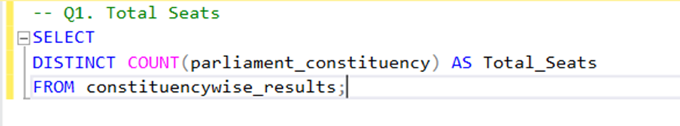
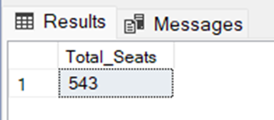

Slide 5
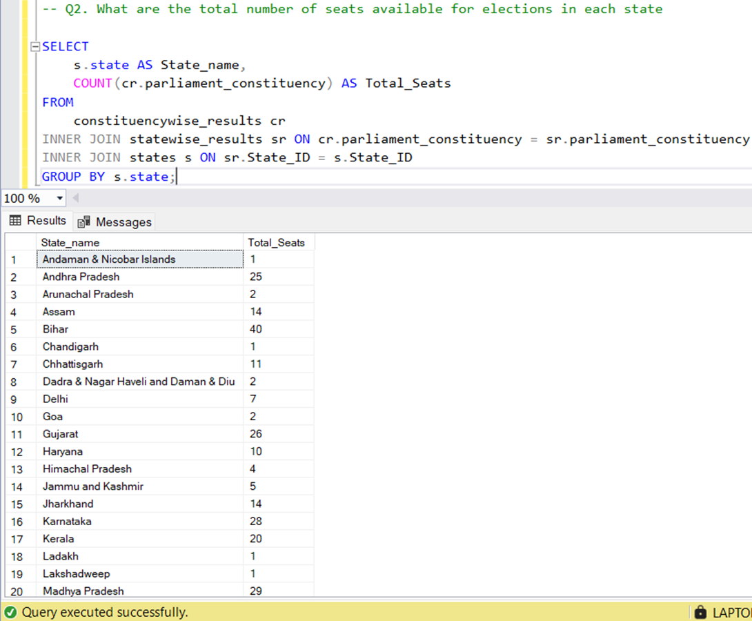

Slide 6
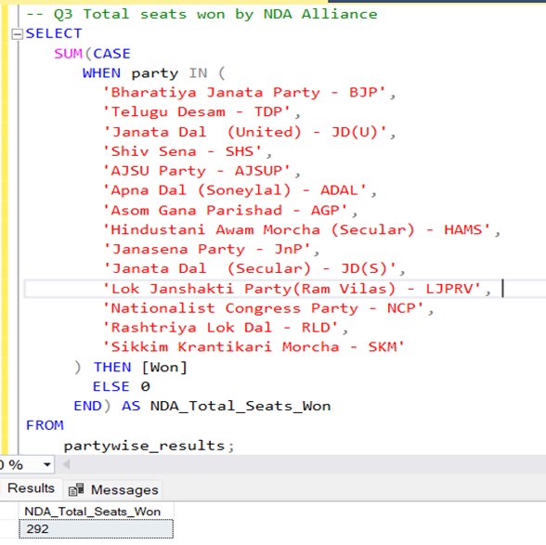

Slide 8
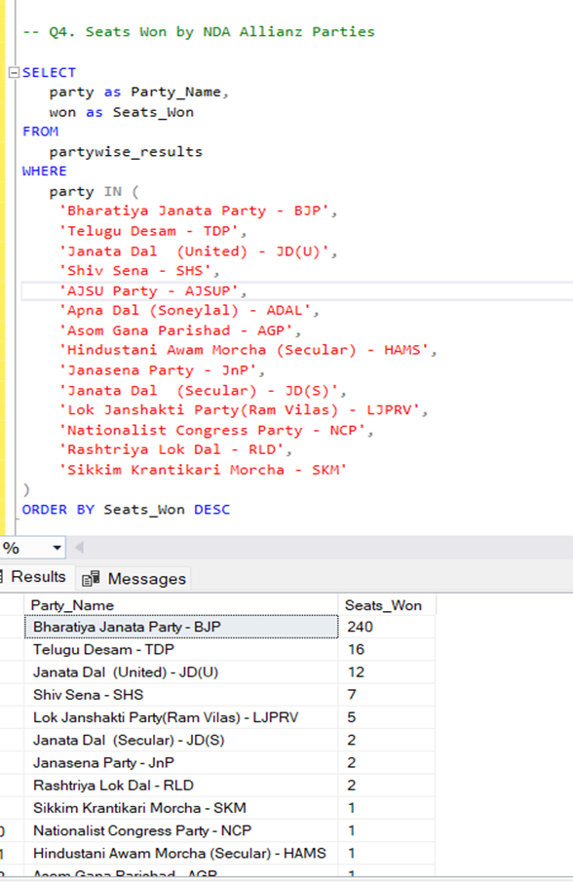

Slide 9
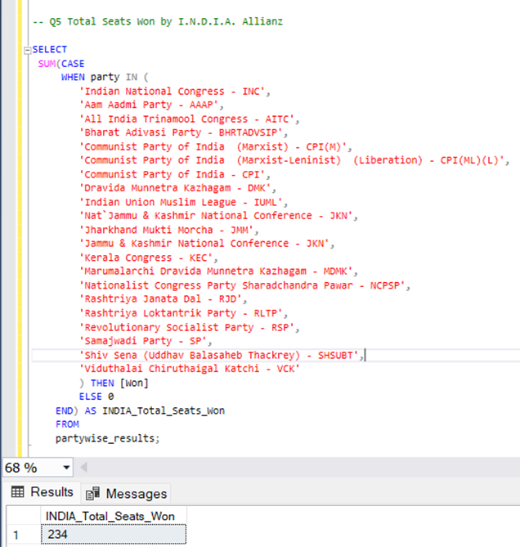

Slide 10
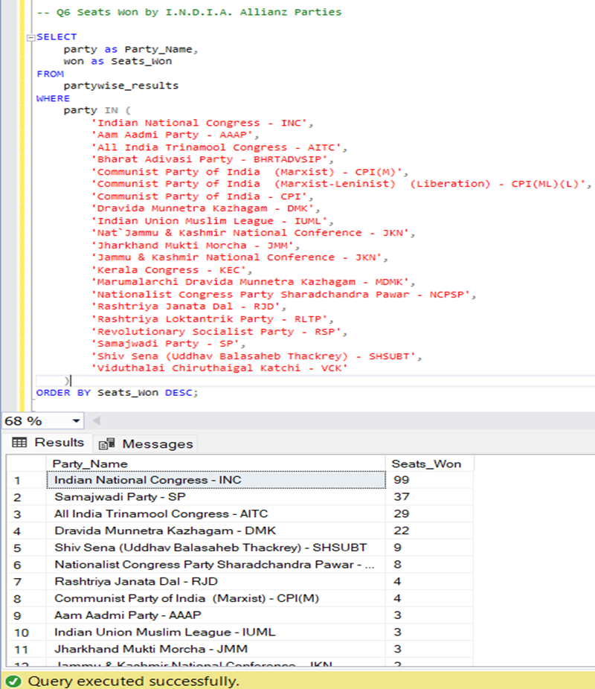

Slide 12
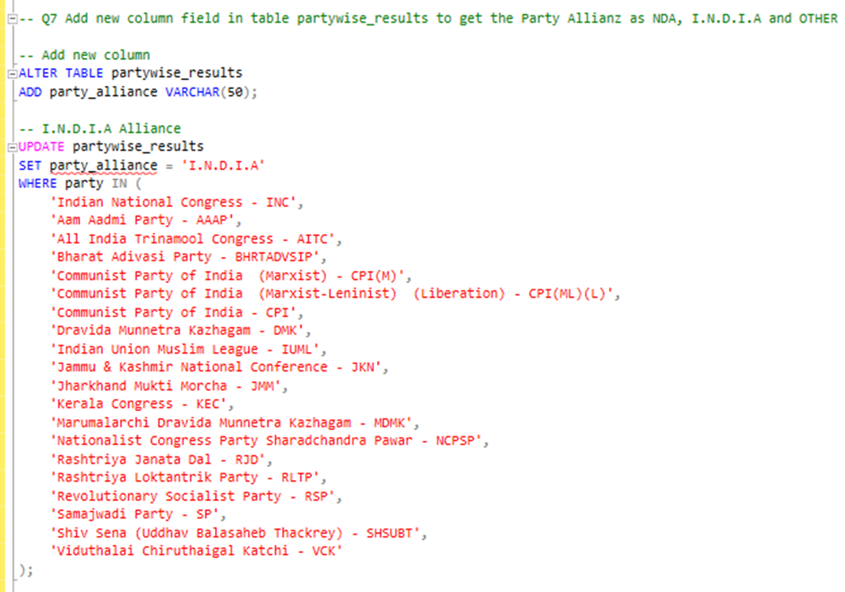
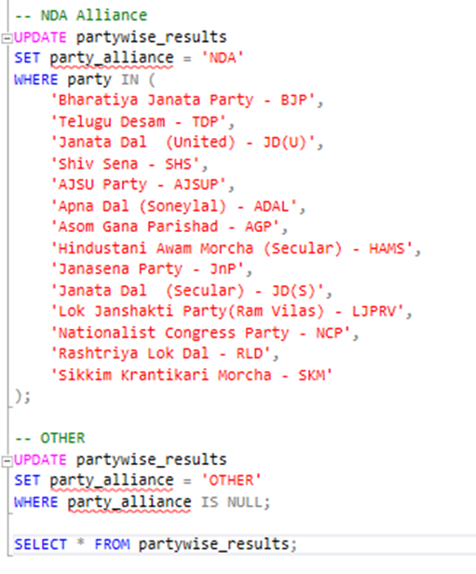

Slide 13
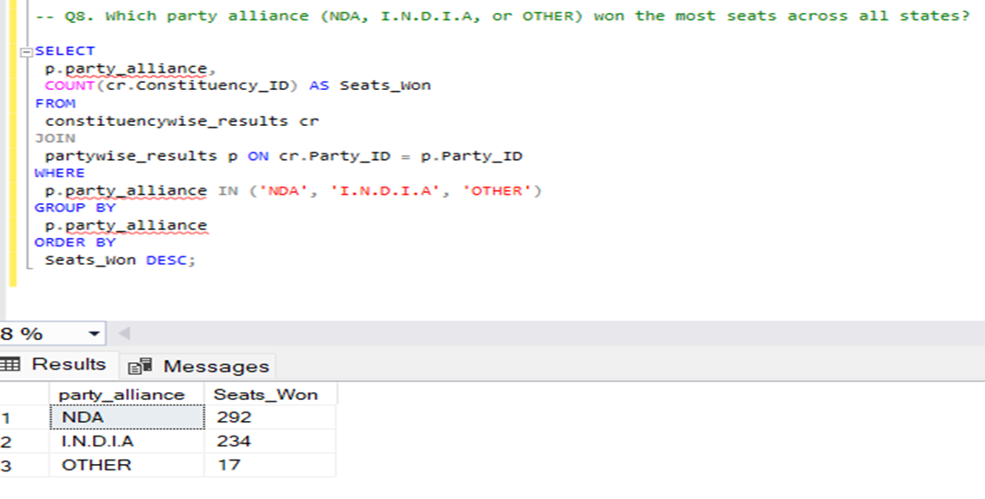

Slide 14
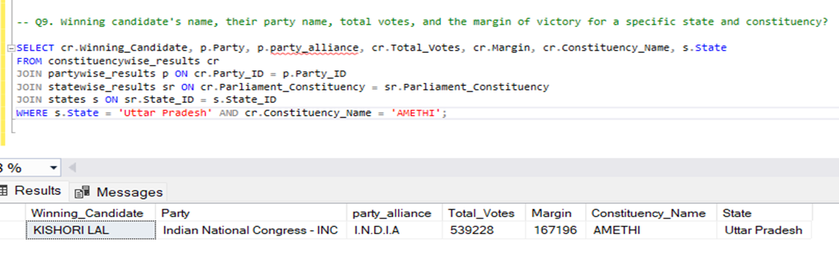

Slide 15
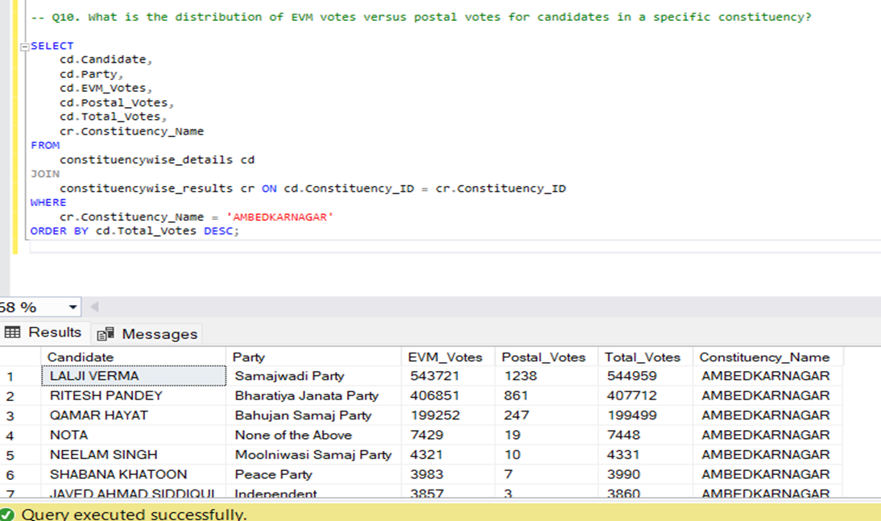

Slide 16
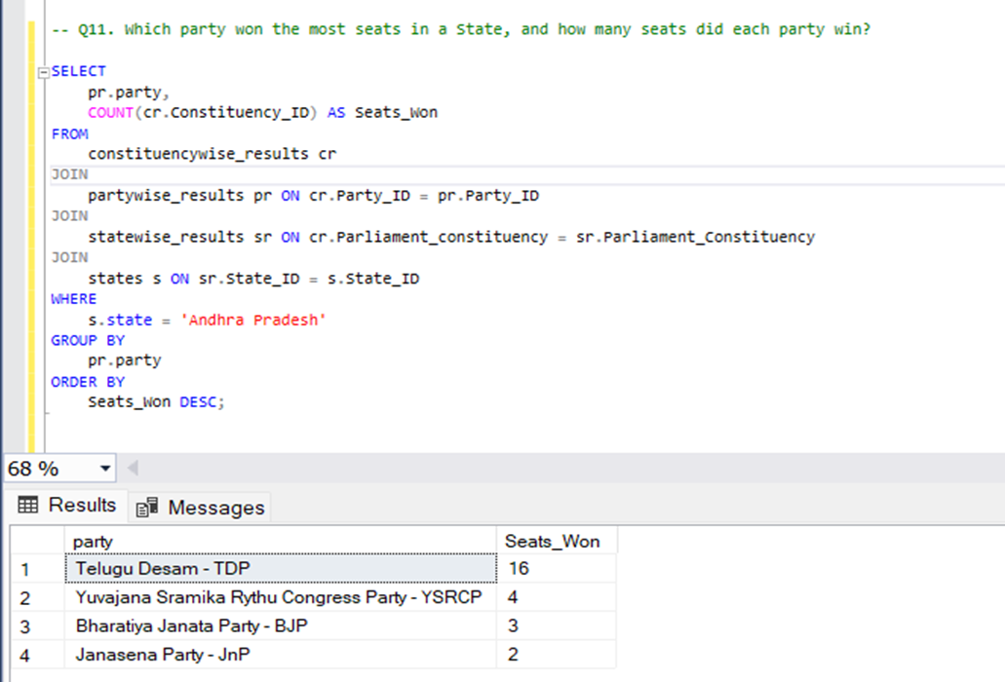

Slide 17
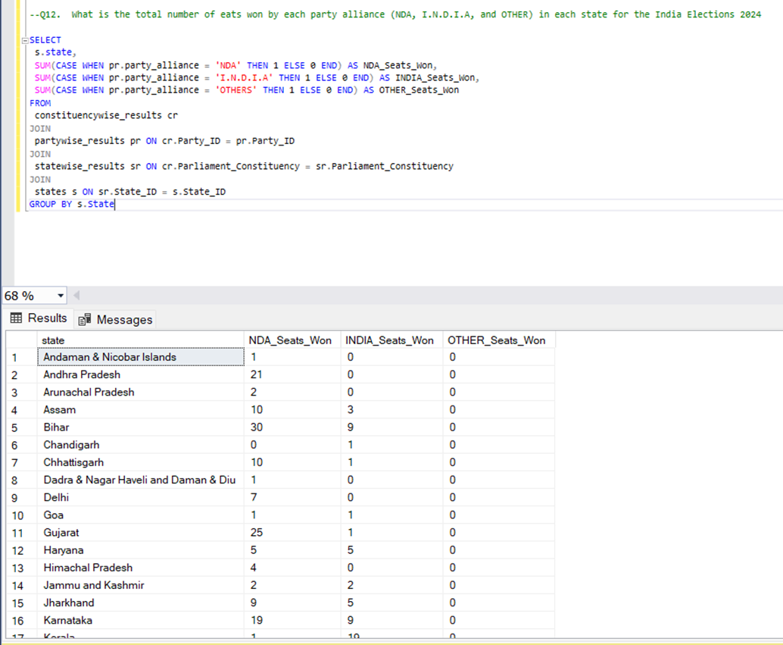

Slide 18
Thank you

